Slide 1
Build your writing skills with the Government Communication Service
Timeless tips to have more impact
Notes:
Presenter 1
Hello and welcome to our session on writing skills.
Today’s session is full of practical tips you can apply to any writing you do in your job – whether it’s strategy papers, guidance, customer communications or just emails to colleagues.

Slide 2
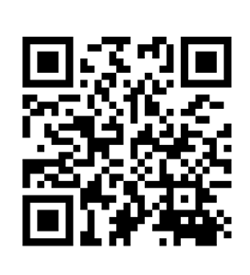
Join the conversation …
Join at: www.slido.com
Participant code: #CSL23
Room: Capital Suite 11
Notes:
Presenter 1
It’s an interactive session with a couple of exercises, so we’d love for you to get involved via Sli.do.
Here are the details – we’ll just give you a moment to put the details into your phone.
If you have questions throughout the session, please send them through on Sli.do and we’ll get to as many of them as we can at the end.

Slide 3
Hello
Notes:
Presenter 1
But first, we’d like to introduce ourselves.
[Presenters to each give a very short intro – name, job role, organisation and a bit about your writing credentials if relevant]

Slide 4
What we’ll cover
Why it’s important
Three things you can do today
Q&A
Notes:
Presenter 1:
So here’s what we’re going to cover today.
Firstly, we’ll talk about why good writing skills are important in our roles as civil servants.
We’ll then move on to three things you can do right now to become a better writer at work.
And we’ll hopefully have a bit of time at the end for some questions.

Slide 5
Why it’s important
Notes:
Presenter 1
So, before we get into talking about writing tips and techniques, let’s talk about the why.
Why is it important that, as civil servants, we write clearly and well?
We want to know what you think.

Slide 6
Why it’s important?
Join at: www.slido.com
Participant code: #CSL23
Room: Capital Suite 11
Notes:
Presenter 1
So please tell us on Slido, but in ONE WORD ONLY why you think it is important?
We’ll give you a moment to do that, and then we’ll have a look at the results.
[The Slido results will show up on a wordcloud – spend a few moments highlighting some of the main themes/picking out some of the most interesting answers.]

Slide 7
Writing clearly helps us…
communicate effectively with the public
make our communications accessible
protect our reputation
work more efficiently
give better advice
meet the Civil Service Code
Notes:
Presenter 1
Some really interesting answers there – thank you for that.
Here are some reasons we thought of:
It’s a vital part of communicating effectively with the public, whether they need to pay their tax, claim benefits, apply for a driving licence or passport, or interact with Government policy in any way
A related point – writing clearly makes our communication accessible to more people. As government, we need to make sure that everyone who needs access to information can access it. Complex language can often be a barrier so we need to write clearly for all our audiences
Writing well helps protect the reputation of the Government and the Civil Service – it shows competence and clear thinking, makes decision making more transparent and builds trust
It makes us more efficient - the more concisely and succinctly we write, the quicker and easier it is to get things done
It helps us give better advice by setting out information clearly for the busy senior people we work with
The Civil Service Code says we must ‘deal with the public and their affairs fairly, efficiently, promptly, effectively and sensitively’ – and writing in a clear, straightforward, human way helps us achieve that.
And now I’ll hand over to [Presenter 2] to talk you through an example.

Slide 8
A quick example
Notes:
Presenter 2
We’re going to show you a piece of writing now – it’s a letter from a school to parents.
It’s a really nice letter in lots of ways – the tone is warm, and the language is pretty clear and simple.
But there’s one big thing wrong with it. Let’s take a look.

Slide 9
Our partnership with the Woodland Trust
Dear parents/carers,
Next week, we will be working with the Woodland Trust to give all our children the opportunity to be involved in planting a tree in our school.
Tree planting is an incredible way for children to connect with nature while helping the planet. It links to many areas of the curriculum and it’s a fun and hands-on activity.
When you plant trees, you make a difference to your whole school and the wider community:
Green spaces improve physical and mental health
Trees and hedges provide homes and food for wildlife
Trees clean the air we breathe
Trees absorb CO2 – one of the main causes of climate change
Here are the days when each year will take part:
Monday: Nursery and Reception
Tuesday: Years 1 and 2
Wednesday: Years 3 and 4
Thursday: Years 5 and 6
Please can children bring trainers or wellies to school on their day, so that they can be out on the field, planting trees!
Notes:
Presenter 2
[Read full letter aloud]
So what’s wrong with this letter?
Imagine you’re a busy parent. You’ve got lots on your plate – a house to run, maybe a full-time job or other children to look after. You’re probably going to be skim-reading this. You’d be forgiven for thinking, ‘Oh, planting trees – that’s nice’, and not paying much attention.
But there is one important piece of information in this letter – and it’s right at the end.

Slide 10
Our partnership with the Woodland Trust
Dear parents/carers,
Next week, we will be working with the Woodland Trust to give all our children the opportunity to be involved in planting a tree in our school.
Tree planting is an incredible way for children to connect with nature while helping the planet. It links to many areas of the curriculum and it’s a fun and hands-on activity.
When you plant trees, you make a difference to your whole school and the wider community:
Green spaces improve physical and mental health
Trees and hedges provide homes and food for wildlife
Trees clean the air we breathe
Trees absorb CO2 – one of the main causes of climate change
Here are the days when each year will take part:
Monday: Nursery and Reception
Tuesday: Years 1 and 2
Wednesday: Years 3 and 4
Thursday: Years 5 and 6
Please can children bring trainers or wellies to school on their day, so that they can be out on the field, planting trees!
Notes:
Presenter 2
Here it is:
Please can children bring trainers or wellies to school on their day, so that they can be out on the field, planting trees!
It’s the thing we want our reader to do (or, what in communications we call the ‘call to action’) – and it’s really easy to miss.
If the school sends the letter out as it is, chances are there are going to be some children going home with wet and muddy feet.
Instead, we need to put the most important information at the top. That way, the reader can’t miss it. Here’s what that looks like…

Slide 11
Please pack wellies for your child next week
Dear parents/carers,
Next week, all our children will have the opportunity to be involved in planting a tree in our school with the Woodland Trust. Please can your child bring trainers or wellies to school, as we’ll be out on the field,
getting muddy!
Here are the days when each year will take part:
Monday: Nursery and Reception
Tuesday: Years 1 and 2
Wednesday: Years 3 and 4
Thursday: Years 5 and 6
The benefits of tree planting
Tree planting is an incredible way for children to connect with nature while helping the planet. It links to many areas of the curriculum and it’s a fun and hands-on activity.
When you plant trees, you make a difference to your whole school and the wider community:
green spaces improve physical and mental health
trees and hedges provide homes and food for wildlife
trees clean the air we breathe
trees absorb CO2 – one of the main causes of climate change.
Notes:
Presenter 2
[Read aloud]
Please pack wellies for your child next week
Dear parents/carers,
Next week, all our children will have the opportunity to be involved in planting a tree in our school with the Woodland Trust. Please can your child bring trainers or wellies to school, as we’ll be out on the field,
getting muddy!
…and then you have the list of days when each class is taking part, so the reader knows what day they need to pack the wellies.

Slide 12
Please pack wellies for your child next week
Dear parents/carers,
Next week, all our children will have the opportunity to be involved in planting a tree in our school with the Woodland Trust. Please can your child bring trainers or wellies to school, as we’ll be out on the field,
getting muddy!
Here are the days when each year will take part:
Monday: Nursery and Reception
Tuesday: Years 1 and 2
Wednesday: Years 3 and 4
Thursday: Years 5 and 6
The benefits of tree planting
Tree planting is an incredible way for children to connect with nature while helping the planet. It links to many areas of the curriculum and it’s a fun and hands-on activity.
When you plant trees, you make a difference to your whole school and the wider community:
green spaces improve physical and mental health
trees and hedges provide homes and food for wildlife
trees clean the air we breathe
trees absorb CO2 – one of the main causes of climate change.
Notes:
Presenter 2
So as you can see here, we’ve got the main message here in the main header, and again in the second sentence.
That way, the reader is getting the most important information right at the start. All the stuff about the benefits of planting trees is nice to have, but not essential – if they stopped reading after the list of days, they wouldn’t be missing anything vital.
So that’s the first thing we’re going to ask you do in your writing when you get back to your desks…

Slide 13
1. Put your main point first
Notes:
Presenter 2
Put your main point first.
And it’s important to emphasise that this is the case no matter what you’re writing – it’s not just about letters.
How many times have you opened a strategy paper or briefing, only to be confronted with three pages of background info? Keep the background info in the background – put your main point first.
How many times have you opened an email and had to scroll all the way to the end to understand what it’s about? Don’t make your reader scroll. Put your main point first.
It works for pretty much everything you could write.

Slide 14
Ask yourself three questions
Who am I writing to?
What do I want them to know?
What do I want them to do?
Notes:
Presenter 2
To help decide what your main point is, you just need to ask yourself three questions:
Who am I writing to?
What do I want them to know?
What do I want them to do?
From that, you can figure out what your main point is, and put it first. If you start doing this, you’ll notice a huge difference in how effective your communications are.
And now back to [Presenter 1] for the second thing you can do today to become a better writer.

Slide 15
2. Shorten your sentences
Notes:
Presenter 1
So here’s thing number 2: shorten your sentences.
Now this one sounds really obvious. But it’s really easy to forget about when we’re writing something. We get carried away and, before we know it, our sentences are getting longer.
This is a really good one to be conscious of. And you don’t need any specialist writing knowledge to put it into practice. It’s just counting.

Slide 16
Longer sentences are harder to read
11 words easy
21 words fairly difficult
25 words difficult
29 words+ very difficult
Notes:
Presenter 1
We all know this intuitively but it’s backed up by research: longer sentences are harder to read.
Here’s a piece of research from the GOV.UK writing guidelines.
It shows that sentences of 11 words are considered easy to read, while those of 21 words are fairly difficult.
At 25 words, sentences become difficult, and 29 words or longer, very difficult.
So to make things easier to read, we advise aiming for an average of 20 words. That doesn’t mean you can’t write a sentence longer than 20 words. But if you have to write, say, a 26-word sentence, try to follow it with, for example, a 12-word sentence. Lots of long sentences in a row make your information a lot harder to digest.
Varying the length of your sentences is also a really good way to keep your reader interested. Here’s a quote from a writer called Gary Provost…

Slide 17
This sentence has five words. Here are five more words. Five-word sentences are fine. But several together become monotonous. Listen to what is happening. The writing is getting boring. The sound of it drones. It’s like a stuck record. The ear demands some variety.
Now listen. I vary the sentence length, and I create music. Music. The writing sings. It has a pleasant rhythm, a lilt, a harmony. I use short sentences. And I use sentences of medium length. And sometimes, when I am certain the reader is rested, I will engage him with a sentence of considerable length, a sentence that burns with energy and builds with all the impetus of a crescendo, the roll of the drums, the crash of the cymbals – sounds that say listen to this, it is important.
Gary Provost
Notes:
Presenter 1
[Read aloud – we suggest adding a bit of drama here ☺]
Now, a little caveat here…

Slide 18
This sentence has five words. Here are five more words. Five-word sentences are fine. But several together become monotonous. Listen to what is happening. The writing is getting boring. The sound of it drones. It’s like a stuck record. The ear demands some variety.
Now listen. I vary the sentence length, and I create music. Music. The writing sings. It has a pleasant rhythm, a lilt, a harmony. I use short sentences. And I use sentences of medium length. And sometimes, when I am certain the reader is rested, I will engage him with a sentence of considerable length, a sentence that burns with energy and builds with all the impetus of a crescendo, the roll of the drums, the crash of the cymbals – sounds that say listen to this, it is important.
Gary Provost
Notes:
Presenter 1
This last sentence is 54 words long. Please don’t do this in any of your work documents. Save it for your novel ☺
But the point is: varying the length of your sentences creates a nicer rhythm and, if you keep things relatively concise, makes you writing easier to read.
Let’s look at an example of that…

Slide 19
It’s time for us to take a hard look at what we’ve been doing, building on those elements that worked well, but also being honest about what needs to get better – particularly given recent public, stakeholder and media criticism, which demonstrates that positive sentiment may be waning.
(47 words)
It’s time for us to take a hard look at what we’ve been doing. We need to build on what’s worked well. But we should also be honest about what needs to get better. This is particularly true given recent criticism from the public, stakeholders
and media.
(14, 9, 11, 13 words)
Notes:
Presenter 1: first click
[Read the long sentence aloud]
So we’ve got a very long sentence here at 47 words. Remember that the research showed that anything over 29 words is very difficult to read, so 47 is going to be extremely difficult for a lot of people.
What you can do with long sentences is just split them into lots of shorter sentences, like we’ve done here:
Second click
[Read the paragraph aloud]
So we’ve got 14, 9, 11 and then 13. The variation gives it a nice rhythm. And it’s much easier to read.
So keep an eye on the length of your sentences. It’s a simple thing that works wonders.
And now back over to [Presenter 2] for the third thing.

Slide 20
3. Write more like you speak
Notes:
Presenter 2
So here’s the final thing we’re going to ask you to do: write more like you speak.
This one isn’t quite as simple as the first two, but it’s really important. It’ll make your writing easier to read, but it’ll also make it feel much more human.
Now, we know not everyone agrees with us on this. So before we talk about what it looks like or how to do it, we’re just going to deal with a couple of arguments that we often hear from people who are worried about it.
Here’s the first one…

Slide 21
Isn’t that ‘dumbing down’?
Notes:
Presenter 2
Isn’t that ‘dumbing down’?
So people often worry that, if they write more like they speak, they’ll sound less intelligent. In fact, the opposite is true – and that’s according to science.
A professor at Princeton University set out to test this hypothesis. He took some pieces of writing and created three versions:
A simple version
A slightly more complex version
A complex version
He gave the extracts to readers and asked them to rate how intelligent and how confident the writers were.
Well, I think you can probably see where I’m going with this. Readers rated the authors of the simpler pieces as more intelligent and more confident than the authors of the more complex pieces.
My favourite thing about this study is its title, which is…

Slide 22
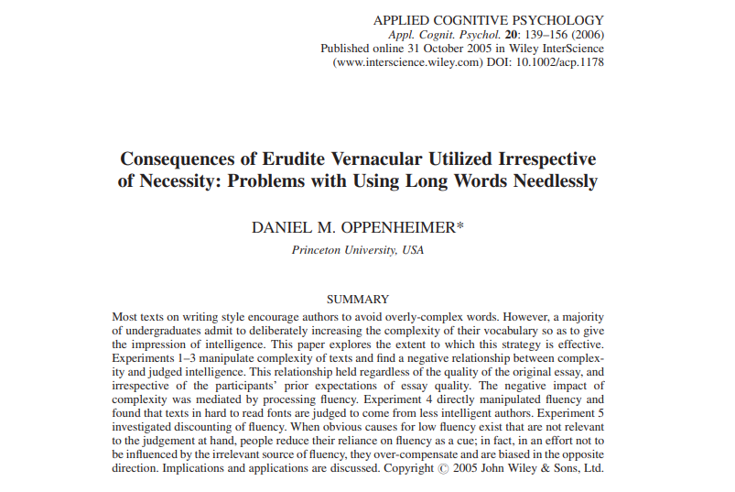
Notes:
Presenter 2
Consequences of Erudite Vernacular Utilized Irrespective of Necessity: Problems with Using Long Words Needlessly.
This is a big problem in the civil service. We’re writing about important topics and we want to come across as serious and knowledgeable. For some of us, that translates into using complex or formal language.
But I’m here to tell you that you’ll come across as more serious and knowledgeable if you use simpler language. And I’m not the only one who thinks that – let’s hear from Winston Churchill.

Slide 23
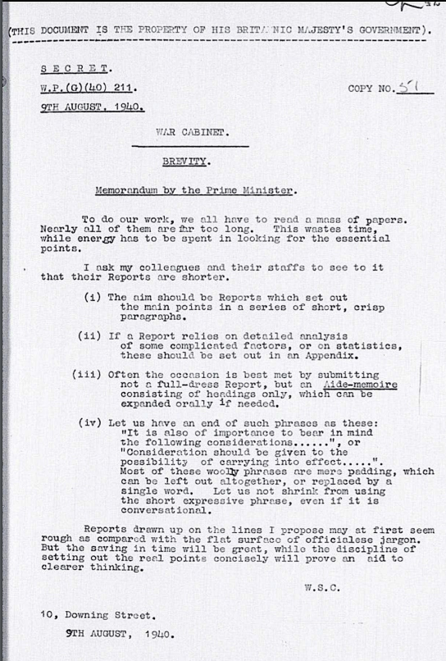
“To do our work, we all have to read a mass of papers. Nearly all of them are too long …
Let us not shrink from using the short expressive phrase, even if it is conversational ...
…The saving in time will be great, while the discipline of setting out the real points concisely will prove an aid to clearer thinking.”
Winston Churchill, 9 August 1940
Notes:
Presenter 2
In 1940, Churchill wrote a memo to his War Cabinet, asking them to use simpler, more conversational language in their papers. In other words, he was asking them to write more like they speak.
[Read the quotes aloud, with extra emphasis on the point about the ‘short expressive phrase’]
So if it was good enough for Churchill, I reckon it’s good enough for us.
Another objection we hear a lot is…

Slide 24
But I have to write for senior leaders…
Notes:
Presenter 2
But I have to write for senior leaders.
The assumption being that, if you’re writing for a Very Important Person, you have to use more formal language. The problem is, that just isn’t supported by evidence.
Research shows that people with higher literacy levels prefer plain English because it allows them to understand the information as quickly as possible.

Slide 25
As education increases, so does the preference for plain language
There was a statistically significant correlation between educational level and the likelihood that a respondent would choose the plain-language version. That is, as education increased, so did the preference for plain language.
Professor Christopher R. Trudeau, The Public Speaks: An Empirical Study of
Legal Communication
Notes:
Presenter 2
One study found that
80% of people preferred sentences written in clear English - and the more complex the issue, the greater that preference
the more educated the person and the more specialist their knowledge, the more they preferred plain English
Here’s an extract from the study:
[Read it aloud]
Now, perhaps the author of the study could have made his own language a bit plainer. But still, you get the point.
People understand complex specialist language, but they don’t want to read it if there’s an alternative. Why would they? Senior people have a lot to read and a ton of other stuff to do. Nobody has ever said, “I really wish this strategy paper were longer and more complicated.”
Hopefully we’ve convinced you that writing more like you speak is a good idea. But how do you do it? Here are a few things to try.

Slide 26
Write more like you speak
Use ‘we’ and ‘you’
Use contractions (sometimes)
Use everyday language
Notes:
Presenter 2
Firstly, use personal pronouns like ‘we’ and ‘you’ – it helps make your writing feel warmer and more direct
Secondly, use contractions. That means the shortened versions of words like ‘we’ll’ instead of ‘we will’ or ‘don’t’ instead of ‘do not. Again it makes your writing feel more natural and human, and studies show it can also make text easier to read. A small caveat on this one is that GOV.UK style doesn’t allow all contractions so if you’re writing for them, check out their rules first
Thirdly, use everyday language. Use the sort of words you’d use in conversation with a colleague, and avoid words that are overly formal or complex.
Let’s do a quick exercise to show you what we mean.
We’re going to flash up a few words that are more formal or complex than they need to be. We want you to shout out a more everyday alternative.

Slide 27
require
Notes:
Presenter 2
Need

Slide 28
ensure
Notes:
Presenter 2
Make sure

Slide 29
provide
Notes:
Presenter 2
Give

Slide 30
prior to
Notes:
Presenter 2
Before

Slide 31
additionally
Notes:
Presenter 2
Also, and
Simple, right? So there you are: five words to swap right away. There are lots of others.
I’m going to show you quite an extreme example now of language that’s much more complex than it needs to be. This is an extract from a letter going to people who owe tax to an overseas government.

Slide 32
Write more like you speak
The addressee can make 1 request only to receive this document in 1 of the other official languages of the European Union. Such a request must be made within 7 working days following the first date on which this Uniform instrument permitting enforcement in the requested member state is communicated to him or used against him. Such a request must be addressed to the person communicating or using the Uniform instrument permitting enforcement in the requested member state.
Such later transmission of another translation of the Uniform instrument permitting enforcement in the requested member state does not affect the validity of the recovery or precautionary measures already taken on the basis of the Uniform instrument permitting enforcement in the requested member state.
If you need a translation
Please contact us if you need to receive the enclosed notice in one of the other official languages of the European Union. You can only ask once, and you must do this within 7 working days of receiving this letter.
If you ask for a translation, it won’t affect any measures we’ve taken to collect this debt.
Notes:
Presenter 2 – first click
[Read the left panel aloud remember to keep clicking to reveal content]
Now that’s pretty complicated stuff. Remember that this letter is going to expats, so English might not be their first language. It’s almost impossible to understand what it means on a first reading.
Second click
Here’s what it was rewritten to:
[Read the right panel aloud remember to keep clicking to read content]
It’s much simpler but it also feels much warmer and more human.
So we’re going to get you to write something now. Don’t worry, it’s not some complex legal notice. Instead, we’re going to get you to think about something that pretty much everyone in this room will have written at some point in their working lives: their out of office.
How many times have you written, or received, something that sounds a little bit like this…

Slide 33
I am currently out of the office on annual leave until 25 July 2023. My inbox will not be monitored in my absence.
If you require urgent assistance, please contact Sunny Holiday. Alternatively, I will respond upon my return.
Notes:
Presenter 2
[Read aloud – put on a slightly formal/robotic-sounding voice]
A funny thing happens to some of us when we write our out of office. We use language that we’d never use in real life.
Would you say to a friend that you ‘require urgent assistance’? Probably not. And ‘upon my return’ sounds like something you’d say if you were going to war in the 19th century, not off to the Costa del Sol.
So we’d like you to rewrite this out of office using more everyday language, and put it on Slido.
[Click to move to the slido code]

Slide 34
Join the conversation …
Join at: www.slido.com
Participant code: #CSL23
Room: Capital Suite 11
Notes:
Presenter 2
A reminder of the Slido details for the audience to participate… then ask AV to put up slido results
[Read out some of the rewrites from Slido]

Slide 35
I’m on leave until 25 July. If it’s urgent, please email Sunny Holiday. Otherwise, I’ll be in touch when I’m back.
Notes:
Presenter 2
Some great suggestions there, thank you. Here’s our version.
So if you’re going to challenge yourself to start to write more like you speak, why don’t you start with your out of office… and then see what else you can change.

Slide 36
To sum up
Put your main point first
Shorten your sentences
Write more like you speak
Notes:
Presenter 1
So, as a recap, here are the three things you can do today to become a better writer:
Put your main point first
Shorten your sentences
Write more like you speak

Slide 37
A few more tips
Read it out loud
Get a second pair of eyes
Sleep on it
Notes:
Presenter 1
And here are a few last tips to help you with the drafting process.
Firstly, read what you’ve written out loud. This is much easier to do now that many of us work from home some of the time.
Reading out loud is a great way to catch sentences that are too long. (The biggest giveaway is that you’ll run out of breath halfway through.) Also, if you find yourself feeling uncomfortable or putting on a funny voice, chances are the tone isn’t quite right. It might even be a bit too formal, so try swapping in some everyday words if you can.
Secondly, get a second pair of eyes. It’s really hard to be objective about your own writing, especially if you’ve had your head in it for days or weeks on end. So get someone else to read it. They may well be able to make some helpful suggestions (and spot the odd typo, too).
Thirdly, sleep on it. If you’re writing something important, try reading it again after a night’s sleep. Again, it’s a way of becoming a bit more objective about what you’ve written, and you might have a fresh perspective in the morning.

Slide 38
What next?
Apply these tips to your next piece of writing
Share them with others in your team
Do some further learning
Notes:
Presenter 2
Before we go to questions, here are some things we’d love for you to do after this session.
Firstly, apply these tips to your next piece of writing. It doesn’t have to be a big strategy paper – it could be the next email you write.
Secondly, share these tips with others in your team. The more people who know to put their main point first, shorten their sentences and write more like they speak, the more effectively we’ll communicate throughout the civil service.
And finally, look into some further learning. We have some suggestions for that on the next slide.

Slide 39
Further learning
Writing for GOV.UK
Government campus
  Foundations of Writing in Government
  Advance Your Writing in Government
Written Communication (face-to-face)
Writing effective emails (GCS)
Notes:
Presenter 1
Have a look at the GOV.UK writing guidelines.
There are online courses on government campus - Foundations of Writing in Government and Advance Your Writing in Government
There’s also a face-to-face course, Written Communication, that you can book via Civil Service Learning
And GCS have a quick e-learning course on writing effective emails.

Slide 40
Any questions?
Join at: www.slido.com
Participant code: #CSL23
Room: Capital Suite 11
Notes:
Presenter 1
And now over to you for any questions. Here are the Slido details for you to join in.
If you don’t have access to Sli.do and would like to ask a question, do put your hand up.

Slide 41
Thank you

